Slide 1


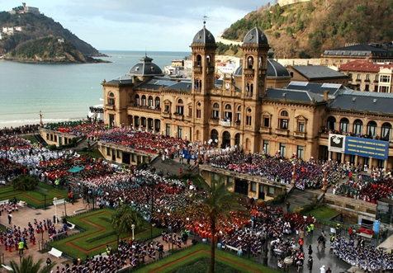

The University of the Basque Country
Faculty of Chemistry
Department of Material Physics
Magnetism Research Group
Magnetic Microwires for Sensor Applications
A. Zhukov^{1,2,3}*, M. Ipatov^{1,2}, P.Corte-León^{1,2}, J. M. Blanco², and V. Zhukova^{1,2}
¹Dpto. de Fís. Mater., UPV/EHU San Sebastián 20009, Spain
²Dpto. de Fís. Aplicada., UPV/EHU San Sebastián 20009, Spain
³ Ikerbasque, Basque Foundation for Science , Bilbao, Spain.
1

Slide 2
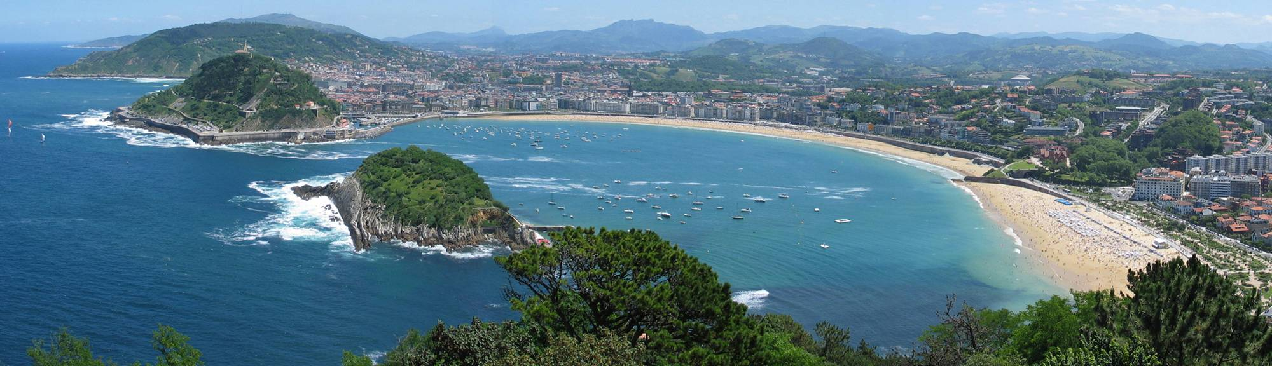
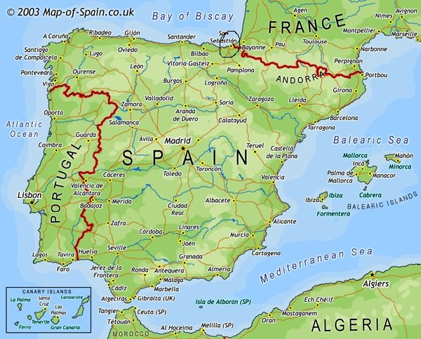
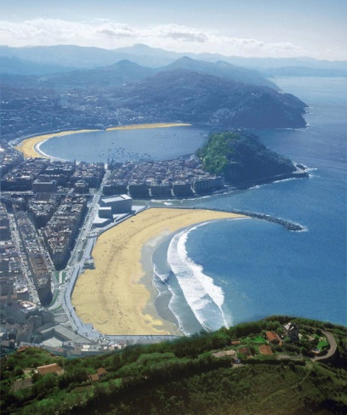
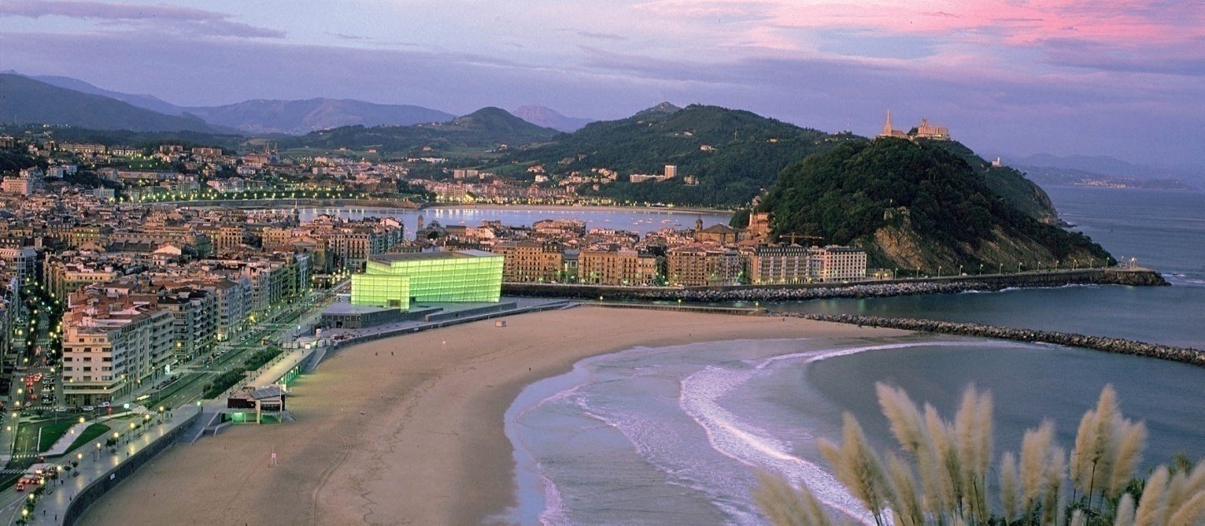
Outline
1. INTRODUCTION
1.1. STATE OF THE ART ON MAGNETIC wires, magnetic properties and applications
1. 2.MOTIVATION.
2. MEASUREMENTS METHODS
3. MAGNETIC PROPERTIES OF as-prepared microwires
3.1. TUNNING OF DOMAIN WALL DYNAMICS
3.2. TUNNING OF HYSTERESIS LOOPS AND GMI
4. CONCLUSIONS

Slide 3
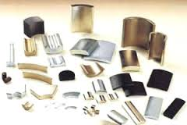
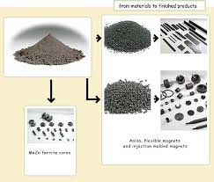



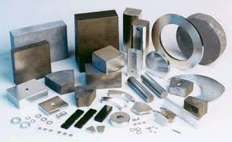
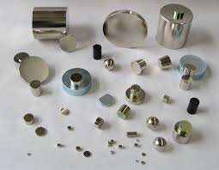
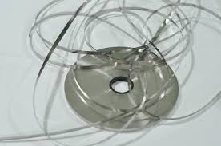
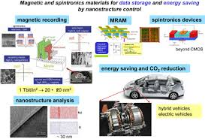

Magnetic materials…
and applications

Slide 4
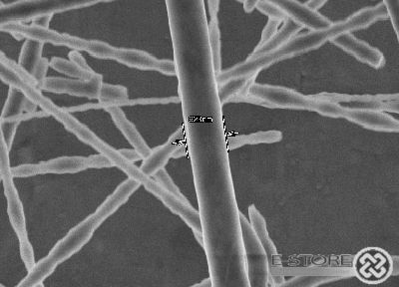

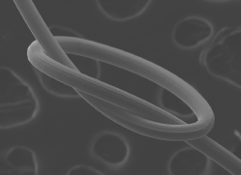
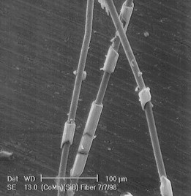
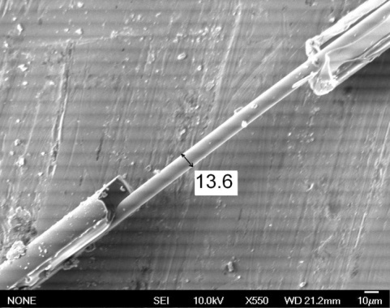
Magnetic wires:
-Iron whiskers
-Wiegan magnetic wires
(CoVFe,1970-th)
Amorphous: milli
(since 80-th) micro
nano
wires
In-rotating water wires
(can be drawn to 20-30 μm) – rough surface
Melt extracted (40-50 μm)- not perfectly cylindrical cross section
Glass coated (0.1-50 μm)- glass coating (stresses)

Slide 5
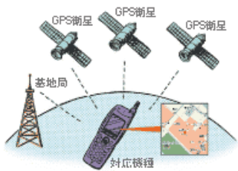
Promising applications: 1. Magnetic sensors and smart composites
Smart composites
Third Generation of Magnetic Sensors
Transceiver
MI Sensors with excellent performance!
Microwave radiation
! Nobel Prize
2007
e
k
Based on Amorphous Wwire since 2010
External stimuli: strain, compression, magnetic field, or heating
Industrial application in Smart phone using MI sensor
Last tendencies: Size reduction, frequency increasing
Soft magnets are needed
Source: Aichi Micro Intelligent Corporation

Slide 6
Promising applications: 2. Magnetic magnetic memory and logic based on DWP
Requisite: controlable DWP
1 of 10 most emerging technologies in 2009
Technology review 2009, published by MIT
Problems:
1. Fast DWP (speed)
2. Controlled DW pinning
Stuart S. P. Parkin, et al. Science 320, 190 (2008);

Slide 7
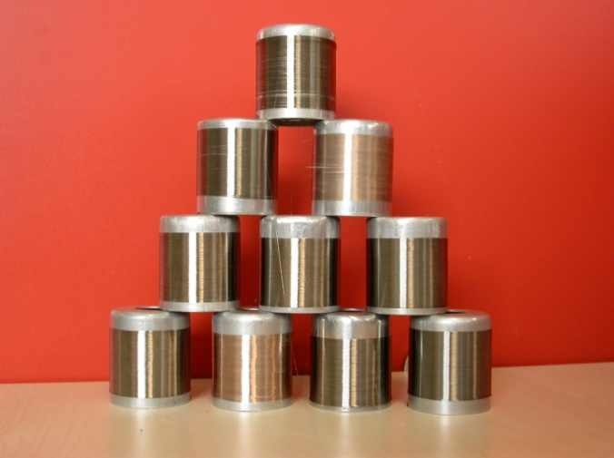
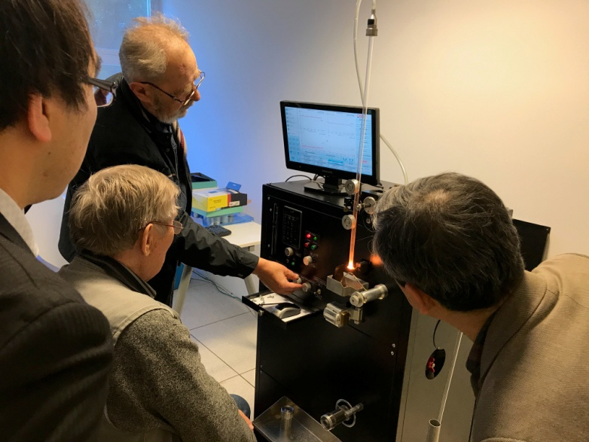
Glass coated microwires
Co, Ni , Fe and Cu rich compositions
dmetal
Dtotal
metal
Glass coating
glass tube
Molten alloy
Typical dimensions:
Total diameter 3-40 microns
Metallic nucleus diameter 1-30 microns
Glass coating thickness 1-10 microns
Length - few km (up to 10 in 1 bobbin)
HF Inductor
Advantages: 1. Unexpensive and simple fabrication method
(1g≈1km)
2. Excellent soft magnetic properites and high GMI effect
3. Fast DW propagation
4. Also recently Heusler-type and granular microwires
5.Biocompatibility (glass-coating)
Water jet
Receiving bobbins
Raw materials saving, better corrosion resistance, robust properties, medical applications…

Slide 8
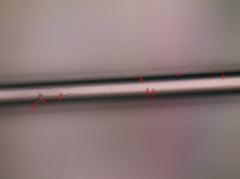
Comparison of microwires with other soft magnetic materials
Ribbons, Cross section above 4 x 10⁴ μm², fast and cheap
fabrication, extremely soft magnetic properties, too big
for microsensors applications
Wires, cross section above 2 x 10³ μm², fast and cheap
fabrication, good magnetic properties, effect of sample
Length - too big for microsensors applications
Thin films, cross section 0.1– 10² μm², slow fabrication,
Higher cost, worse magnetic softness, good compatibility
in integrated circuits, effect of substrate
Microwires, typical cross section above 4- 2 x 10³ μm², fast
and cheap fabrication, extremely soft magnetic properties,
good for microsensors applications
Scale (cross section)

Slide 9
MAGNETIC PROPERTIES OF AMORPHOUS MICROWIRES
As-prepared !
GMI effect, high sensitivity
450%/Oe: 1 Oe = 0,1 mT)
1% MI change ≈0,0002 mT
Fast magnetization switching,
DW velocity up to 2.5 km/s
ν = S (H-H0)
Performance of devices depends on GMI effect value (defined as MI ratio) and DW velocity values.

Slide 10
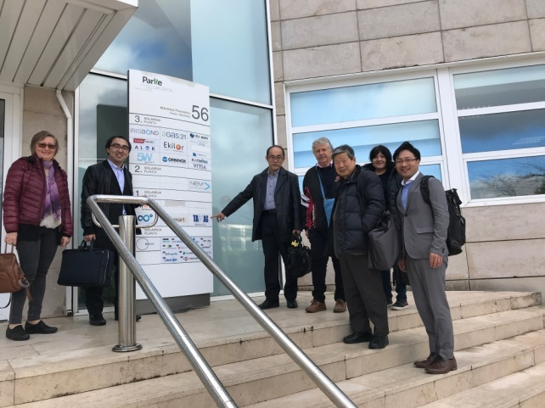

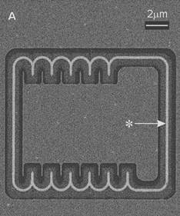
Engineering of magnetic properties of magnetic microwires
Wire based sensors
First step
Non-reversible
Composition
Geometric ratio, ρ
Conditions of thermal treatment (crystallization)
Tuneable
Parameters
Second step: fine tuning
Local heating
Mechanical stress
Axial-circular crossed magnetic field
Conditions of thermal treatment (crystallization)
Reversible
APPLICATIONS
Magnetic microelectronics
Optimal
magnetic
properties
Provided by Prof. K. Mohri
Source: Aichi Micro Intelligent Corporation
S S. P. Parkin, et al. Science 320, 190 (2008);
10

Slide 11
Factors affecting soft magnetic propeties of amorphous alloys
Amorphous materials do not have defects typical for crystalline materials (dislocations, point defects...)
H. Kronmüller (1981) contributions in coercivity of amorphous materials:
Local anisotropy fluctuations (10⁻³–1 me), Hc(i)
Clusters and chemical inhomogeneities (< 1 me), Hc(SO)
Surface defects and iregularities (< 5 Me), Hc(surf)
Local srtuctural defects (0.1-10 me), Hc(rel)
Pinning of DW on defects in magnetostrictive alloys (10-100 Me), Hc(s)
Hc(total)=[ Hc(s)² +Hc(surf)²+ Hc(SO) ²+Hc(i)² ]^{1/2} + Hc(rel)
или
Hc(total)= Hc(s) +Hc(surf)+ Hc(SO) +Hc(i) + Hc(rel)
Magnetostriction
Anisotropy (stresses), induced anisotropy
Clusters and chemical inhomogeneities (nanocrystallization)
Defects (surface)
11

Slide 12
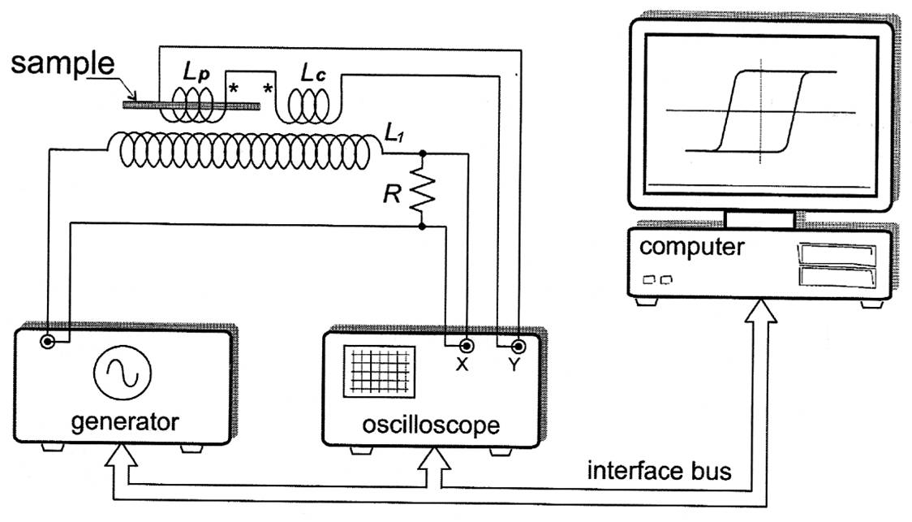
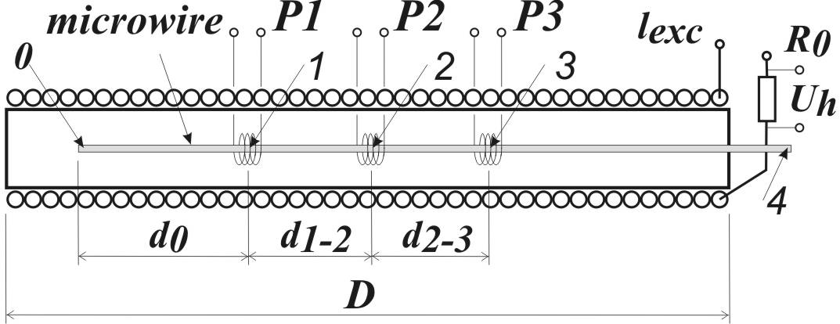
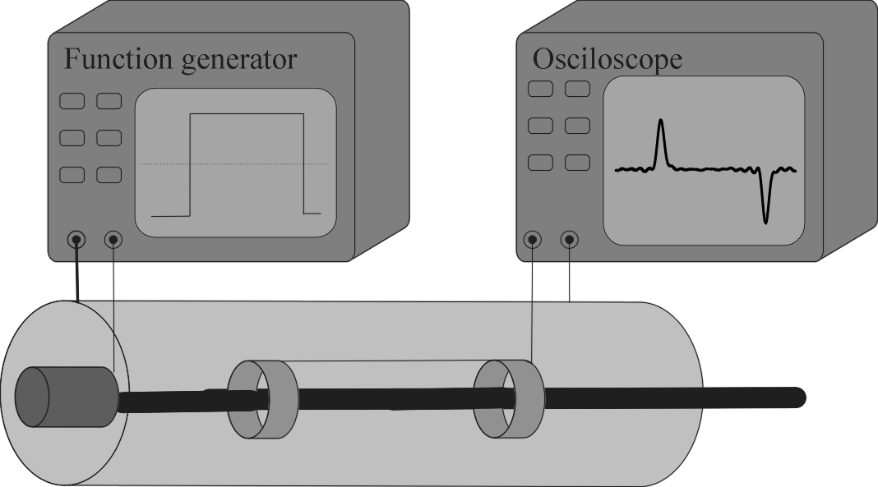
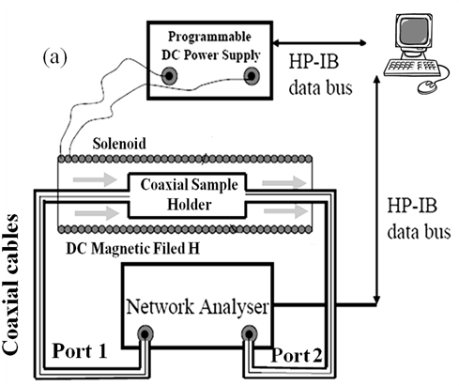
Measurements technique
1. Hysteresis loops
2. Sixtus-Tonks like experiment
Exciting coil
t
4. Measurements of GMI
Microwire
L
V=L/t
Pick up coil
3. Nucleation profile (DW injection)!
H
Hn
12

Slide 13
MAGNETIZATION PROCESSES IN Fe-RICH THIN MAGNETIC WIRES.
M
Yu. Kabanov, A. Zhukov, et al,
Appl. Phys. Lett. 87 (2005) p142507
M
H<Hs
Bistable Loops
(Fe-based microwires)
H
H
Schematic presentation of the re-magnetization process
-
+
-
+
-
+
-
-
-
-
+
+
-
H
-
-
+
-
+
+
-
-
+
+
+
-
-
+
+
-
-
+
+
-
-
-
+
-
+
+
-
-
+
+
+
-
+
+
-
+
+
-
-
-
+
+
-
+
-
-
+
+
+
-
+
-
-
+
+
+
-
+
13
-
-
+
+
-
-
-

Slide 14
Comparison of domain wall dynamics measured in amorphous
Fe –rich microwire and Fe-Ni rich planar nanowires.
Measured mobility curve for a
490nmx20nm Permalloy nanowire
G.S.D. Beach et al. / J. Magn. Magn. Mater.
320 (2008) 1272–1281
Experimentally observed maximum v ≈110 m/s at
9 Oe
d≈2,8 μm and total diameter D≈ 9μm
ρ=0,31
DW dynamics measured in Fe-rich microwire and in Fe-Ni rich planar nanowires.

Slide 15
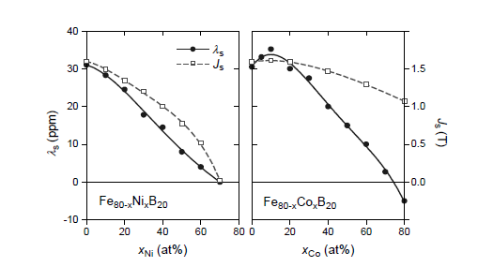
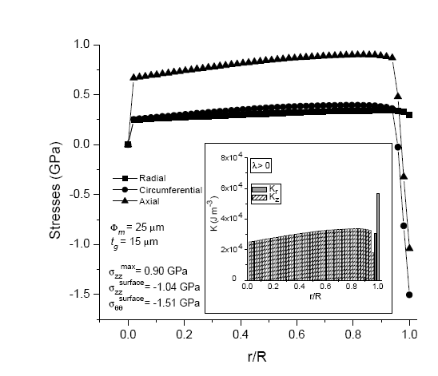
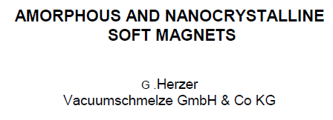
Magnetoelastic energy
K_{me} ≈ 3/2 λ_{s}σ_{i}, :
Magnetostriction λ_{s} -determines by the chemical composition
σ= σ_{i +} σ_{a}
σ_{a‘}- applied stresses
σ_{i} -determines by the ratio ρ=d/D
Internal stresses in composite microwires
Stress appears at simultaneous solidification of metallic alloy inside the glass coating
K (J/м³)
d=20 μm
Φ (μм)
d=6 μm
σ (MPa)
σ=f(ρ), ρ =d /D
d=2 μm
Т
t (μм)
15
H. Chiriac, T.-A. Ovari, A. Zhukov, J. Magn. Magn. Mater. 254–255 (2003) 469–471

Slide 16
Effect of magnetolastic anisitropy on DW propagation
Fe-Co microwires
v(H) dependences for Co_{41.7}Fe_{36.4}Si_{10.1}B_{11.8}
microwires with different ratios ρ:
Effect of internal stresses
σ=f(ρ)
Different internal stresses!
v=S(H-H₀)
where S is the DW mobility, H is the axial magnetic field and H₀ is the critical propagation field.
v(H) dependences for Fe₁₆Co₆₀Si₁₃B₁₁ and Co_{41.7}Fe_{36.4}Si_{10.1}B_{11.8} microwires with ρ=0,39:
effect of magnetostriction
ν = S (H-H0)
λ_{s}≈ 20x10⁻⁶
λ_{s}≈ 20x10⁻⁶
λ_{s}≈ 40x10⁻⁶
v(H) dependences for Co_{41.7}Fe_{36.4}Si_{10.1}B_{11.8 3}
microwires (d≈ 13,6μm, D≈ 24,6μm, ρ≈ 0,55 ) measured under application of applied stresses, σ_{a}.

Slide 17
Effect of magnetolastic anisitropy on DW propagation
v=S(H-H₀), where S is the DW mobility,
H is the axial magnetic field and H0 is
the critical propagation field.
λs, Fe62Ni15.5Si7.5B15 ≈ 25 x10⁻⁶;
λs, Fe49,6Ni27.9Si7.5B15 ≈ 15 x10⁻⁶;
The domain wall mobility, S, is given by:
S=2μ₀Μ_{s}/β
This damping is related to the Gilbert damping parameter, α and is inversely proportional to the domain wall width δw,
β_{r}≈αM_{s} /γδ_{w}≈M_{s}(K_{me}/A)^{1/2}
v(H) dependences for Co₅₆Fe₈Ni₁₀Si₁₁B₁₆microwires
measured under application of applied stresses, σ_{app}.
Magnetoelastic energy, K_{me}, is given by
K_{me} ≈ 3/2 λ_{s}σ,
V(H) is affected by Kme

Slide 18
Effect of magnetolastic anisitropy on DW propagation
K_{me} ≈ 3/2 λ_{s}σ_{i},
Stress relaxation?
Tann ≈410 ºC
Fe77.5Si7.5B15
Fe62Ni15Si7.5B15 microwires

Slide 19
Effect of saturation magnetization on DW propagation
The domain wall mobility, S, is given by:
S=2μ0Μs/β
where, μ0Μs is the saturation magnetization
Βr≈Ms(Kme/A)^{1/2}
(Fe0,7Co0,3)83,7Si4B8P3,6Cu0,7
Fe77.5Si7.5B15
Higher S are observed
in new Fe-rich
composition
with higher μ0Μs
V. Zhukova, M. Ipatov, P. Corte-Leon, J.M. Blanco, E. Zanaeva, A.I. Bazlov, J. Jiang, D.V. Louzguine-Luzgin, J. Olivera, A. Zhukov, Excellent magnetic properties of (Fe0.7Co0.3)83.7Si4B8P3.6Cu0.7 ribbons and microwires, Intermetallics 117 (2020) 106660, doi: 10.1016/j.intermet.2019.106660

Slide 20
Stress- Annealing
Dependences of DW mobility, S, on annealing time for Fe₇₅B₉Si₁₂C₄ microwires annealed at T_{ann} = 325 ºC.
Fe75B9Si12C4 microwires
Remarkable DW movility
imrpovement by
stress-annealing!
H
Hysteresis loops (a) and v(H) dependencies (b) of as-prepared and stress- annealed at T_{ann} = 325 ºC and σ_{m}=190 MPa Fe₇₅B₉Si₁₂C₄ microwires.
Stress- Annealing
δ
High permeability of outer shell
δ
P. Corte-León, J. M. Blanco, V. Zhukova, M. Ipatov, J. Gonzalez, M. Churyukanova, S. Taskaev & A. Zhukov, Sci. Reports, (2019), DOI: https://doi.org/10.1038/s41598-019-48755-4

Slide 21
Grading of magnetic anisotropy and engineering of domain wall dynamics in Fe-rich microwires by stress- annealing
Usially graded anisotropy is obtained varying chemical composition during the sputtering
Hysteresis loops of as-prepared and stress-annealed at different T_{ann} Fe₇₅B₉Si₁₂C₄ microwires (a) and graded magnetic properties of Fe₇₅B₉Si₁₂C₄ microwires annealed at variable T_{ann}.
21
V. Zhukova, J.M. Blanco, P. Corte-Leon, M. Ipatov, M. Churyukanova, S. Taskaev, A. Zhukov, Acta Materialia 155 (2018) 279-285

Slide 22
Engineering of domain wall dynamics in Fe-rich microwires by local stress- annealing
Hysteresis loop (a), v(H) dependence (b), voltage peaks induced by the magnetization change in the pick-up coils (c) and H_{n}(L) dependence (d) of as-prepared Fe₇₅B₉Si₁₂C₄ amorphous glass-coated microwire.
H
2. Nucleation profile (DW injection)!
Coils 1,2,3
Hn
H
σ
Local heating
22
V. Zhukova, J.M. Blanco, P. Corte-Leon, M. Ipatov, M. Churyukanova, S. Taskaev, A. Zhukov, Acta Materialia 155 (2018) 279-285

Slide 23
Promising applications:. Magnetic magnetic memory and logic based on DWP
Requisite: controlable DWP
1 of 10 most emerging technologies in 2009
Technology review 2009, published by MIT
Problems:
1. Fast DWP (speed)
2. Controlled DW pinning
Stuart S. P. Parkin, et al. Science 320, 190 (2008);
₂₃

Slide 24
APPLICATIONS:
Magnetic codification based on magnetic bistability
Publications
A. Zhukov, J.González, J.M. Blanco, M.Vázquez and V. Larin, J. Mat. Res 15, (2000), 2107.
M
Patentes:
V. Larin, A. Torcunov, S. Baranov, M. Vázquez, A. Zhukov and A. Hernando, “Method of magnetic codification and marking of the objects”, Patent (Spain) Nº P 9601993 (1996).
2. M. Vázquez, A. Zhukov, A. Hernando, V. Larin, A. Torcunov, L. Panina, J. Gonzalez and D. Mapps, TITULO:
“Microwire and process of their fabrcation. AWP/RPS/56672/000, No0108373.2 (UE) 01.11.2001
”Four wnds”, Amotec” and ”Tamag Iberica. S.L.”
3. A. Zhukov, V. Zhukova, M. Vázquez, J. González, V. S. Larin y A.V. Torcunov “ Amorphous micwories as an element of magnetic sensor based on magnetic bistabily, magneto-impedance and material for the radiation protection”.
P200202248 (Span) 02.10.2002 ”Tamag Iberica. S.L.”
4 A. Zhukov, V. Zhukova, J. González, V. S. Larin y A.V. Torcunov “Ultra-thin glass-coated microwires with GMi effect at elevated frequencies.”PCT Es/2006/000434 (USA)
H_{c2}
H
H_{c1}
H_{c3}
H
H_{c3}
H_{c2}
H_{c1}
t
t₁
t₂
t₃
V
t
Digital
Codes
0 0 0 0 0 0 0 1 0 0 1 0 0 0 0 0 1 0 0 0 0 0 0 0 0 0 1 0 0 1 0 0 0 0 0 0 1 0
t

Slide 25
APPLICATIONS:
Scheme of the installation to record the EMF signals of magnetic tags; (b) geometry of the working area near the receiving coils.
- receiving coils with a side of a = 20 cm were made of 20 turns
of thin copper wire.
small solenoid with a length 5 cm has been used to excite the
magnetic tags by alternating magnetic field with a frequency
f = 327 Hz and amplitude H₀ = 5 Oe.

Slide 26
APPLICATIONS:
The measured amplitude of 7-th harmonics of the magnetic tag EMF signals as a function of the distance of the tag from the receiving coil plane for the cases when the tag is oriented perpendicular (squares) or parallel (triangles) to the coil plane.
For the given size of the receiving coils the magnetic tag having ~ 100 μm magnetic core diameter can be detected at the distances higher than 45 cm, irrespective of the magnetic tag orientation with respect to the receiving coil plane.
S. Gudoshnikov, N. Usov, A. Zhukov, V. Zhukova, P. Palvanov, B. Ljubimov, O.Serebryakova, and S. Gorbunov,
“Evaluation of use of magnetically bistable microwires for magnetic labels”, Phys. Status Solidi A, 208, No. 3, 526–529 (2011)

Slide 27
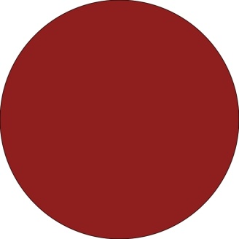
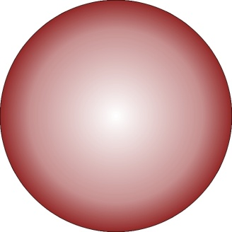
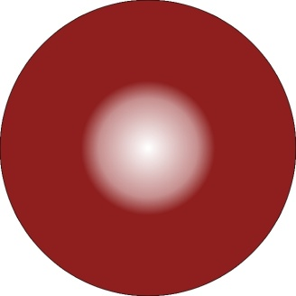
Giant Magneto-impedance effect
500% change
per 1 Oe
Magnetic filed depedence and value are affected by magnetic anisotropy
Skin Effect of the Magnetic Conductor
AC current frequency
f≈ kHz
f≈ MHz
δ
μφ(H,f)
(at high enough f)
Z(H)
2r
Magnetic field
E.P. Harrison, et.al Nature, 1935, vol. 135, p. 961
δ

Slide 28
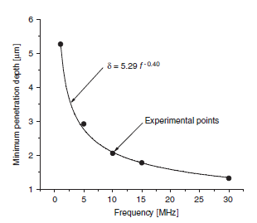
GMI effect
Calculated penetration depth vs. axial dc-field at various frequencies
of ac-current in Co67Fe3.85Ni1.45Mo1.7Si14.5B11.5 microwire
with metallic nucleus diameter 22.4 μm
Essentially surface
effect. Thin surface
layers are involved in
the GMI process
H. Lachowicz, M. Kuzminski, K.L. García, A. Zhukov and M. Vázquez, A. Krzyzevski, “Influence of Alternative circular magnetic field strength on magnetoimpedance of glass-coated micro-wire”, J. Magn. Magn. Mater. 300 (2006), e88-e-92
28
28

Slide 29
Magnetic properties and GMI effect of magnetic microwires
λs ≈ -5 x 10⁻⁶
Co77.5Si15B7.5 (a),
λs ≈ -1 x 10⁻⁷
Co67Fe4Ni1.4Si14.5B11.5Mo1.7 (b)
and
λs ≈ 40 x 10⁻⁶
Fe75B9Si12C4 (c) microwires
μ=ΔΜ/ΔΗ
High μ, low Hc
Good candidate for GMI
29
29
Hysteresis loops, shape and value of GMI ratio are different

Slide 30
TAILORING OF GMI EFFECT AND MAGNETIC PROPERTIES
K_{me} ≈ 3/2 λ_{s}σ_{i}, :
Magnetostriction λ_{s} -determines by the chemical composition
σ_{i} -determines by the ratio ρ=d/D
Effect of the samples geometry on the hysteresis loops of Co-rich
microwires with vanishing magnetostriction constant.
dmetal
Dtotal
metal
Glass coating
Correlation with magnetic anisotropy
Theoretical GMI ratio value is about 3000%
30

Slide 31
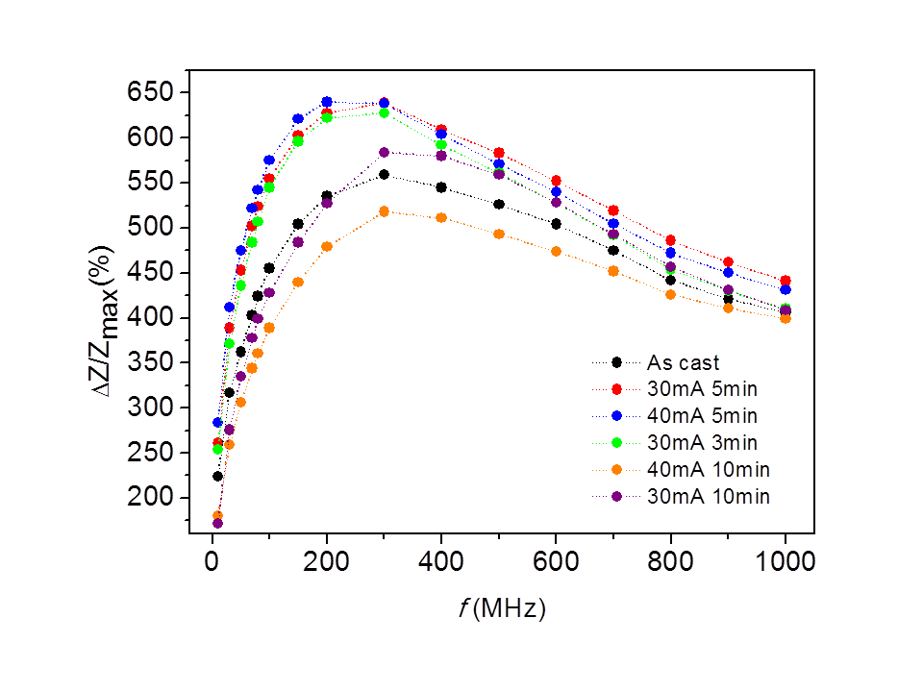
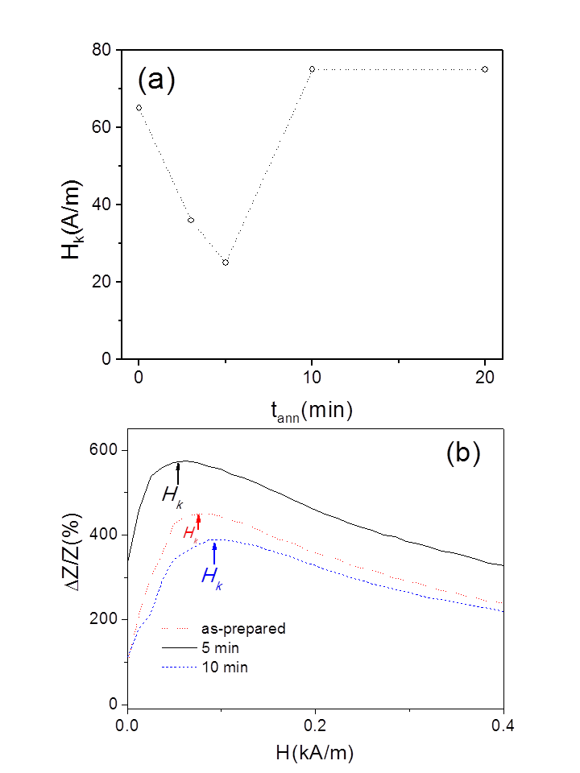
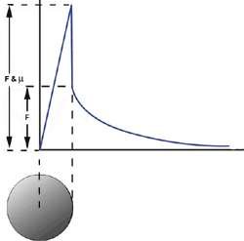
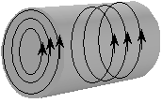
Tailoring by Joule heating
- Internal stresses relaxation
- Induced magnetic anisotropy
GMI ratio up to 650%
Hk=25A/m
Circular magnetic field by current:
Hc=2 A/m
31
V. Zhukova, J.M. Blanco, M. Ipatov, M. Churyukanova, J. Oliver, S. Taskaev, A. Zhukov, Optimization of high frequency magnetoimpedance effect of Fe-rich microwires by stress-annealing, Intermetallics, 94 (2018) 92-98

Slide 32
Ways to improve GMI in Fe-rich microwires
Stress-annealing induced Anisotropy and GMI in Fe-rich microwires
Motivation: Co- critical element!
Fe75B9Si12C4
As-prepared
Stress annealed 200 ºC
Stress annealed 250 ºC
i) considerable transversal magnetic anisotropy and magnetic softening and GMI
enhancement
ii) existence of maximum on ΔZ/Z (H) dependences reflects transversal magnetic
anisotropy of stress-annealed
iii) Excellent mechanical properties (amorphous material)
V. Zhukova, M. Ipatov, A. Talaat, J. M. Blanco, M.Churyukanova, S. Taskaev and A. Zhukov, “Effect of stress-induced anisotropy on high frequency magnetoimpedance effect of Fe and Co-rich glass-coated microwires” J. Alloys Compound. 735 (2018) 1818-1825;
V. Zhukova, J.M. Blanco, M. Ipatov, J. Gonzalez, M. Churyukanova A., Zhukov, Scripta Materialia, Vol. 142, (2018)
10–14, doi: 0.1016/j.scriptamat.2017.08.014
32

Slide 33
Ways to improve GMI in Fe-rich microwires
Effect of stress annealing on GMI of Fe -rich microwires
900 MPa
Depend on T, σ
Only partially reversible
SA is a promisng method
for MI optimization in Fe-rich
microwires
V. Zhukova, M. Ipatov, A. Talaat, J. M. Blanco, M.Churyukanova, S. Taskaev and A. Zhukov, “Effect of stress-induced anisotropy on high frequency magnetoimpedance effect of Fe and Co-rich glass-coated microwires” J. Alloys Compound. 735 (2018) 1818-1825
V. Zhukova, J. M. Blanco, M. Ipatov, M.Churyukanova, S. Taskaev and A. Zhukov, Tailoring of magnetoimpedance effect and magnetic softness of Fe-rich glass-coated microwires by stress- annealing, Sci. Reports 8 (2018) 3202

Slide 34
Ways to improve GMI in Fe-rich microwires
Origin of stress-induced anisotropy 1
As-prepared microwire
Internal stresses with mainly axial component
σint
Stress Annealing
Induction of magnetic anisotropy during stress annealing
Slow Cooling under stress
Stress relaxation in the stressed state at room temperature
Elimination of the applied stress
Induction of the compressive stresses at room-temperature (so-called “Back stresses”)
σint
A. Zhukov, Advanced Funcional Materials Volume 16, Issue 5, 2006, pp.675-680
Compensation of axial internal stress

Slide 35
Origin of induced anisotropy 2
Possilbe origin:
Stress induced anisotropy (stress from glass coating)?
σi
metal
Glass coating
Origin: Pair ordering usually considered
TM1 (Co)
TM2 (Fe)
Possible origin 3:
The topological short range ordering (also known as structural anisotropy) can play an important role. This involves the angular distribution of the atomic bonds and small anisotropic structural rearrangements at temperature near the glass transition temperature
H or/and σ
Pair reorientation under field and/or
stress annealing (after Neel)
[1] F. E. Luborsky and J. L. Walter, “Magnetic Anneal Anisotropy in Amorphous Alloys”, IEEE Trans.Magn. Vol.13 (2), pp.953-956, 1977.
[2] J. Haimovich, T. Jagielinski, and T. Egami, “Magnetic and structural effects of anelastic deformation of an amorphous alloy”, J. Appl. Phys. Vol. 57, pp. 3581-3583, 1985.

Slide 36
Tensor character of GMI
Schematic representation
ΔZ/Z
H_{ax}
H_{c}
A.S. Antonov, I.T. Iakubov, A.N. Lagarkov, J. Magn. Magn. Mat. 187 (1998), 252
P. Aragoneses, A. Zhukov, J. Gonzalez, J.M. Blanco and L. Dominguez, Sensors and Actuators A, 81/1-3 (2000) 86-90

Slide 37
Methods for revealing the impedance matrix elements: (a) ς_{zz}, (b) ς_{zϕ}, (c) ς_{ϕz}, (d) ς_{ϕϕ}
D.P.Makhnovskiy, L.V. Panina and D.J. Mapps, Phys Rev B 63 (2001), 1444241.
Or
V. A. Zhukova, A.B. Chizhik, J.Gonzalez , D.P. Makhnovskiy, L.V. Panina, D.J. Mapps and A.P. Zhukov, J Magn Magn Mat. 249 (2002), 3124.

Slide 38
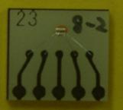
MI element
Sputtering of 2-nd Cu layer
Sputtering of Cu
Microwire with GMI
~V
MI-element
Al bonding
Before bonding of resin
₃₈
Excitation current pulse in the wire (a) and voltage induced in the pickup coil (b).

Slide 39
Off-diagonal GMI of nearly zero magnetostriction Co_{67,1}Fe_{3,8}Ni_{1,4}Si_{14,5}B_{11,5}Mo_{1,7} microwires
Asymmetrical shape,
Almost linear region
Linear region and maximum
Position depends on geometry
Tailoring of GMI by heat treatment

Slide 40

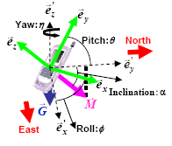
APPLICATIONS:
m-wires –GMISince 2010
MI-element
AMI 601 –Aichi Steel Corp.
6-axis sensor
3 axis of magnetic earth sensing
3 axis acceleration sensing
Size – 1 mm

Slide 41

APPLICATIONS:
Application for MI effect - Sensors
❖ High sensitive electronic compass
❖ Positional sensor  Motion-sensing controllers  Operating attitude automated control.
Motion Sensor = 3D magnetic sensor + 2/3D accelerometer
It determines the attitude of mobile devices relative to geomagnetism and gravity, and by analyzing the attitude and speed, other aspects of movement such as acceleration, translational speed and rotational speed can be calculated.
Source: Aichi Micro Intelligent Corporation
❖ Navigation functions combining the motion sensor with a GPS:
Intelligent Transportation System,
Control of operating attitude in unmanned helicopters, robots, automobiles, etc.
Requirements: high sensitivty at low H (up to few Oe)

Slide 42
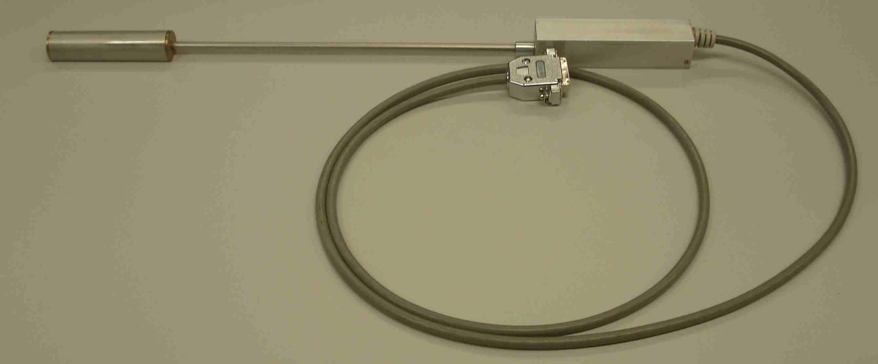
Designed by us magnetometer
Technical characteristics
Channel number 3 (X, Y, Z components);
Size of the 3-component sensing element cube with 14 mm edge;
Input voltage of the channel, not less ± 4.5 V;
Dynamic range, not less ± 2.5 Oe;
Frequency range, not less 1 kHz;
Power voltage 0 + 5.5V;
Consuming current ~ 250 mA;
Transmission coefficient of the channels
Channel X 1.58V per 1Oe;
Channel Y 1.57V per 1Oe;
Channel Z 1.69V per 1Oe.
Noise level (resolution) ≈10 nT

Slide 43
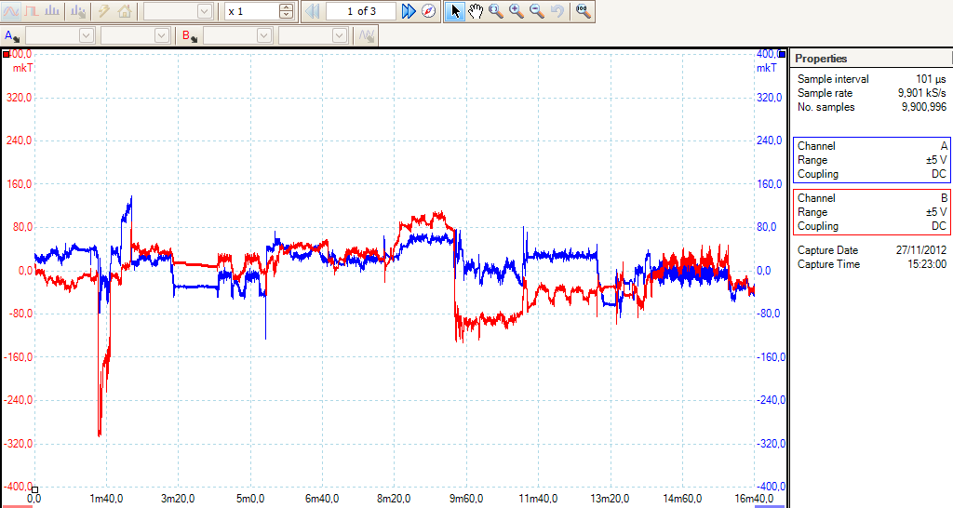
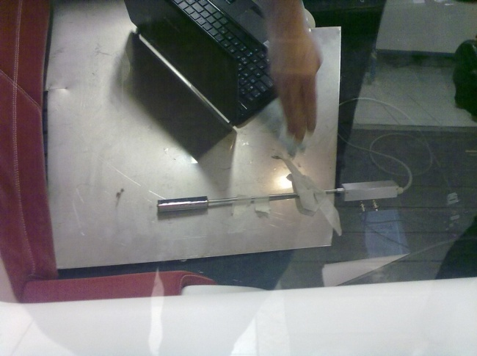
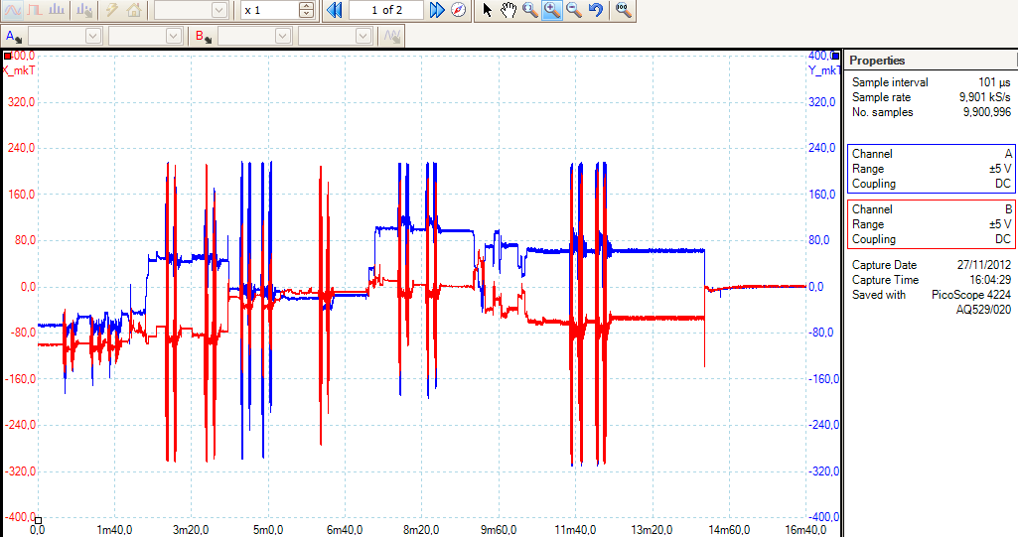
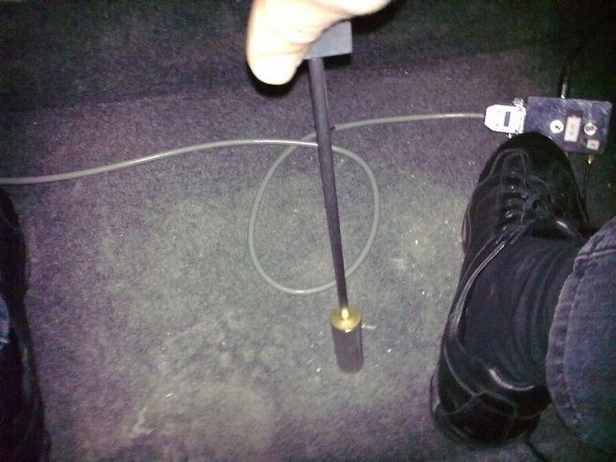
MAGNETIC FIELD MEASUREMENTS WITH GMI MAGNETOMETER inside the electric car (FIAT Turin Nov. 2012) (FP7 project)

Slide 44
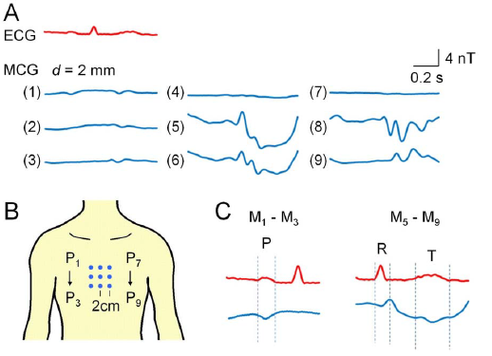
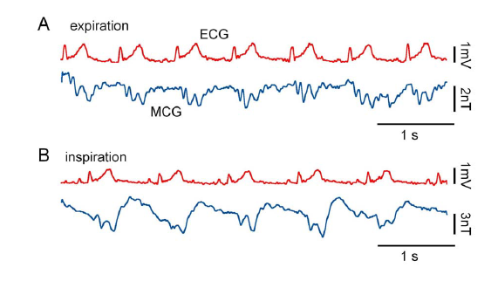
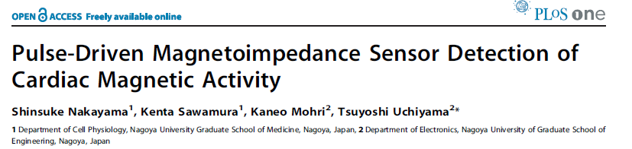
Prospective applications of GMI magnetic fild sensors
₄₄
44
44
44

Slide 45
Magnetic Field and Magnetic Sensors
Bio magnetic
field
Nature magnetic
field
Industrial magnetic field
Space magnetic field
Storage and magnet
Geo-magnetisms
SC-magnet
pT
nT
μT
mT
T
Tesla (T)
kT
10⁻¹⁰
10⁻⁸
10⁻⁶
10⁻⁴
10⁻²
1
10²
10⁴
10⁶
Gauss (G )
nG
μG
mG
G
kG
MG
Hall sensor
(0 ~ 1 MHz)
Intrinsic noise level
at room temperature.
MR, GMR sensor
(0 ~ 10 MHz)
Fluxgate sensor
(0 ~ 10 kHz)
Source: Prof. K. Mohri
Amorphous wire MI sensor
(0 ~ 10 MHz)
SQUID
Proton magnetometer
（0 ~ 0.01Ｈｚ）
₄₅

Slide 46
Tuneable composites with ferromagnetic wires
HF GMI
Magneto-impedance effect (MI)
in ferromagnetic wires
Composite materials with metallic wires
MI at Radio Frequencies
( MHz )
Strong dispersion of the
effective permittivity
MI at GHz
Magnetically tuneable
composite
High sensitivity
magnetic,
stress,
temperature
sensors
Tuneable selective microwave coatings
2) Stress-sensitive media
for remote non-destructive health monitoring.
3) Temperature monitoring composites
₄₆
46
46

Slide 47
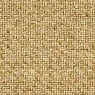
Composite structures
Microwires in
a thermoset matrix
during polymerization
Microwires linear array
ε
Detection coil
Solenoid
Hysteresis loops
Measurements
Transmitting-receiving antenna
Solidifying
composite
Microwaves (1−17 GHz)
H
Glass tube
Radiative near- or far-field
Composite during polymerization
Embedded microwires
Free-space
Measurements
Polymeric matrix
Epoxy vinyl ester resin
FRC: Fiber Reinforced Composite
Receiving antenna

Slide 48
Electromagnetic properties of composites with glass-coated microwire inclusions
The Transmission, T (a) and reflection,R (a) parameters measured using free-space system during the composite solidification.

Slide 49
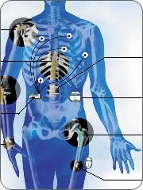
Potential application for stress-sensitive microwires:
remote local stress control
Microwave beam
Microwire antennas
embedded into the implants
Transceiver
₄₉
49

Slide 50
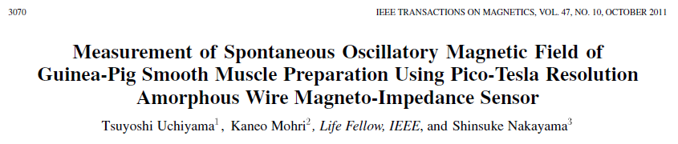
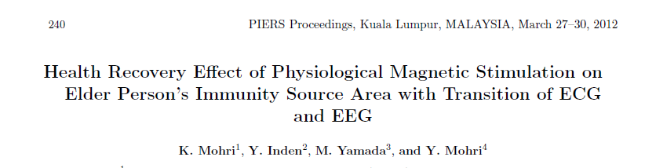
Existing and proposed applications
1. Mobile phones (navigation and games)
2. Bio- and medical applications
3. Tags
4. Smart composites

Slide 51
Present talk : magnetic softness and GMI effect of amorphous microwires
A. Zhukov , J.M. Blanco, M. Ipatov, A. Talaat, V. Zhukova,, “Engineering of domain wall dynamics in amorphous microwires by annealing”, J. Alloys Compounds, Volume 707, 15 (2017), p. 35–40
V. Zhukova, J. M. Blanco, A. Chizhik, M. Ipatov, A. Zhukov, “AC-current-induced magnetization switching in amorphous microwires”, Front. Phys. 13(2), 137501 (2018)
V. Zhukova, J. M. Blanco, M. Ipatov, M.Churyukanova, S. Taskaev and A. Zhukov, Tailoring of magnetoimpedance effect and magnetic softness of Fe-rich glass-coated microwires by stress- annealing, Sci. Reports 8 (2018) 3202
V. Zhukova, J.M. Blanco, M. Ipatov, J. Gonzalez, M. Churyukanova A., Zhukov, “Engineering of magnetic softness and giant magnetoimpedance effect in Fe-rich microwires by stress-annealing”, Scripta Materialia Vol. 142, 1 January 2018, 10–14,
Other features of amorphous microwires:
Crystalline microwires:
Heusler-type (NiMnGa)
Granular microwires
Co-Cu
Magnetric hardening: FePt
A. Zhukov, M. Ipatov, A. Talaat, A. Aronin, G. Abrosimova, J.J. del Val and V. Zhukova, Magnetic hardening of Fe-Pt and Fe-Pt- M (M=B, Si) microwires, J. Alloys Compound., Volume 735, (2018) pp.1071–1078
A. Zhukov, M. Ipatov, J.J. del Val, S. Taskaev, M. Churyukanova and V. Zhukova, “First-order martensitic transformation in Heusler-type glass-coated microwires”, Appl.Phys. Lett. DOI: 10.1063/1.5004571
V. Zhukova, J. Mino, J.J. Del Val, M. Ipatov, A. Martinez-Amesti, R. Varga, M. Churyukanova, A. Zhukov, “Magnetoresistance and Kondo-like behaviour in Co5Cu95 microwires”, J. Alloys Compound. 674 (2016) 266-271

Slide 52





Conclusions
Soft magnetic properties, GMI and fast DW propagation are observed in magnetic microwires.
By appropriate selection of chemical composition and post-processing conditions we can considerably improve GMI effect and magnetic softness in Co-rich microwires and DW velocity in Fe-rich microwires
Excellent magnetic properties are suitable for several sensor applications
Thank you for the attention!
“Advances in Giant
Magnetoimpedance
Materials” by A. Zhukov, M. Ipatov and V. Zhukov
(issue October 2015)
Questions: e-mail: arcadyzh@hotmail.com

